Slide 1
University of St. Thomas Graduate Programs in Software Internet of Things SEIS 744 IoT Final Project Weather Frame
By Basma Alboug

Slide 2
The Weather frame IoT project
Every day before I leave home I check the weather on my phone to know what should I ware. Especially here in Minnesota the weather can drop or rise up to 10 degrees in the same day. So, I thought it would be nice to have a wall decor that provide the updated weather information
It Match the IoT concept
I wanted to use the stuff I bought

Slide 3
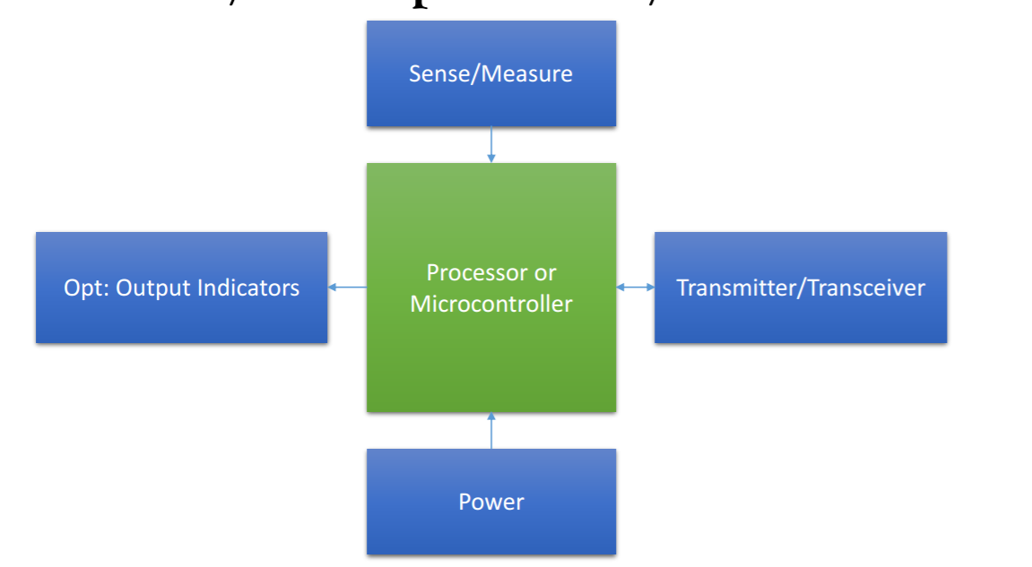
How does it match the IoT concept
Moisture sensor grove
D1 Wifi UNO based ESP-8266
LCD blue shield
Object
Shadow box
Arduino UNO
Wall USB charger

Slide 4
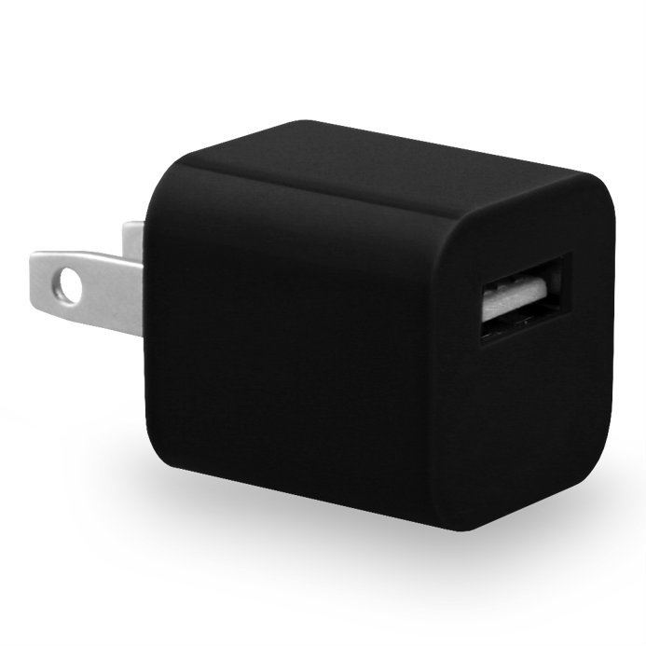
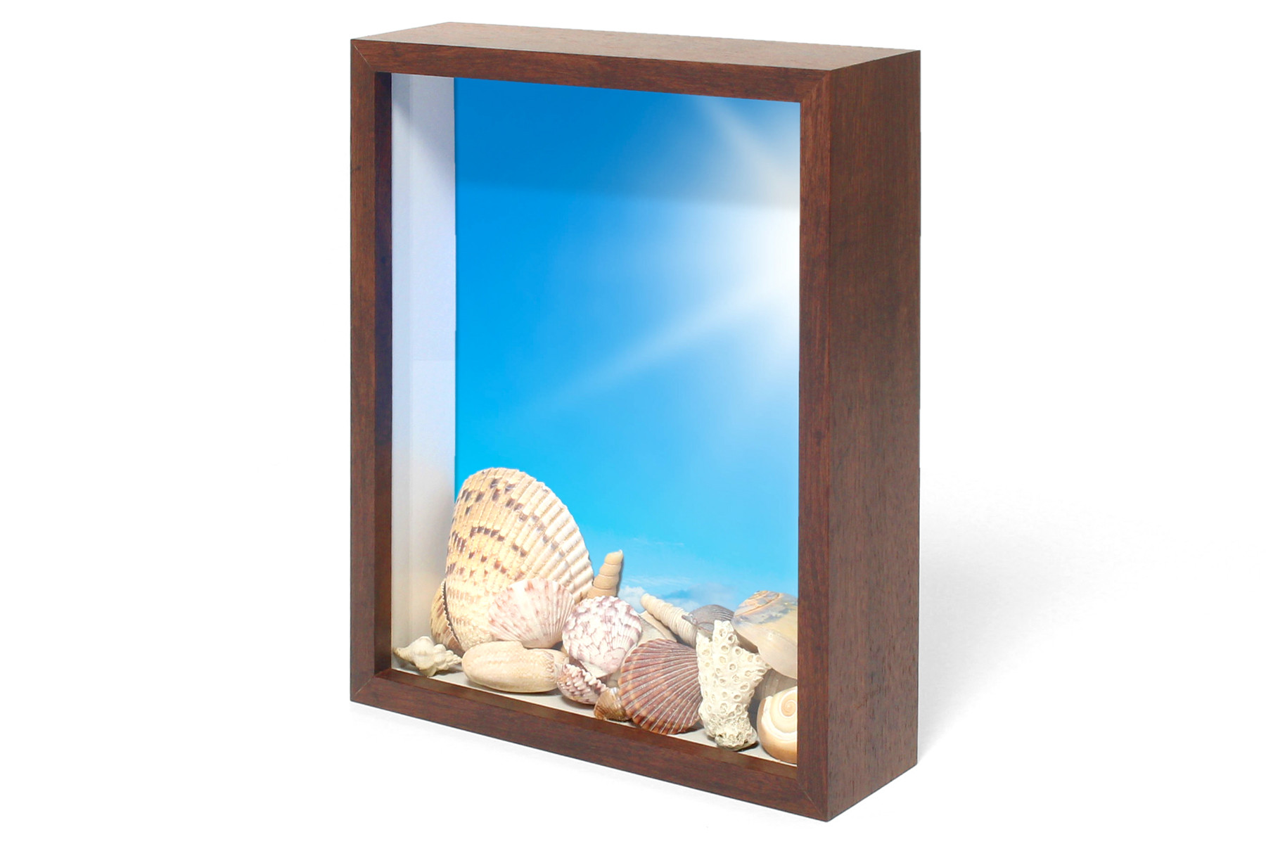
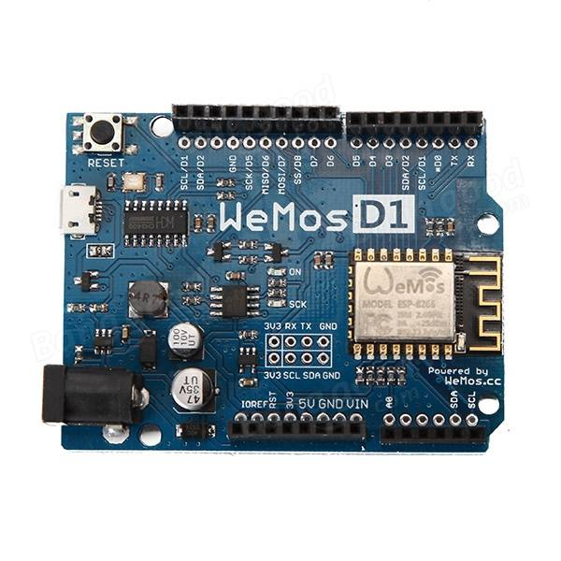
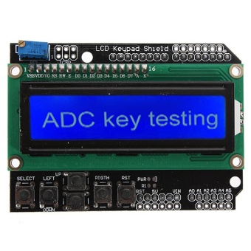
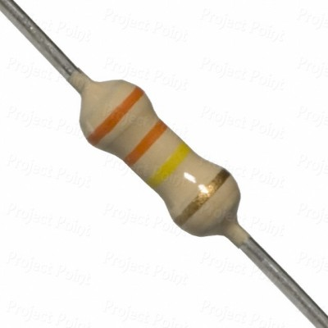
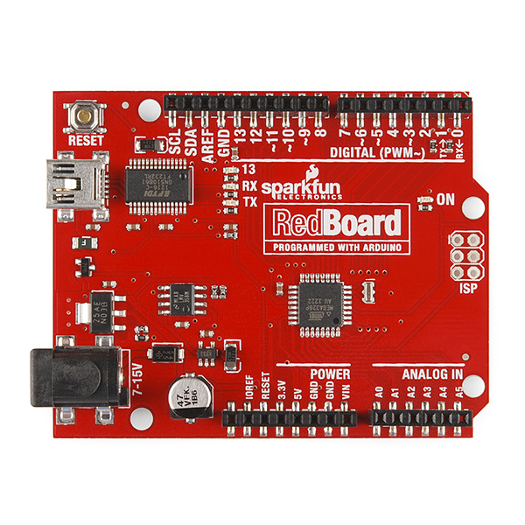
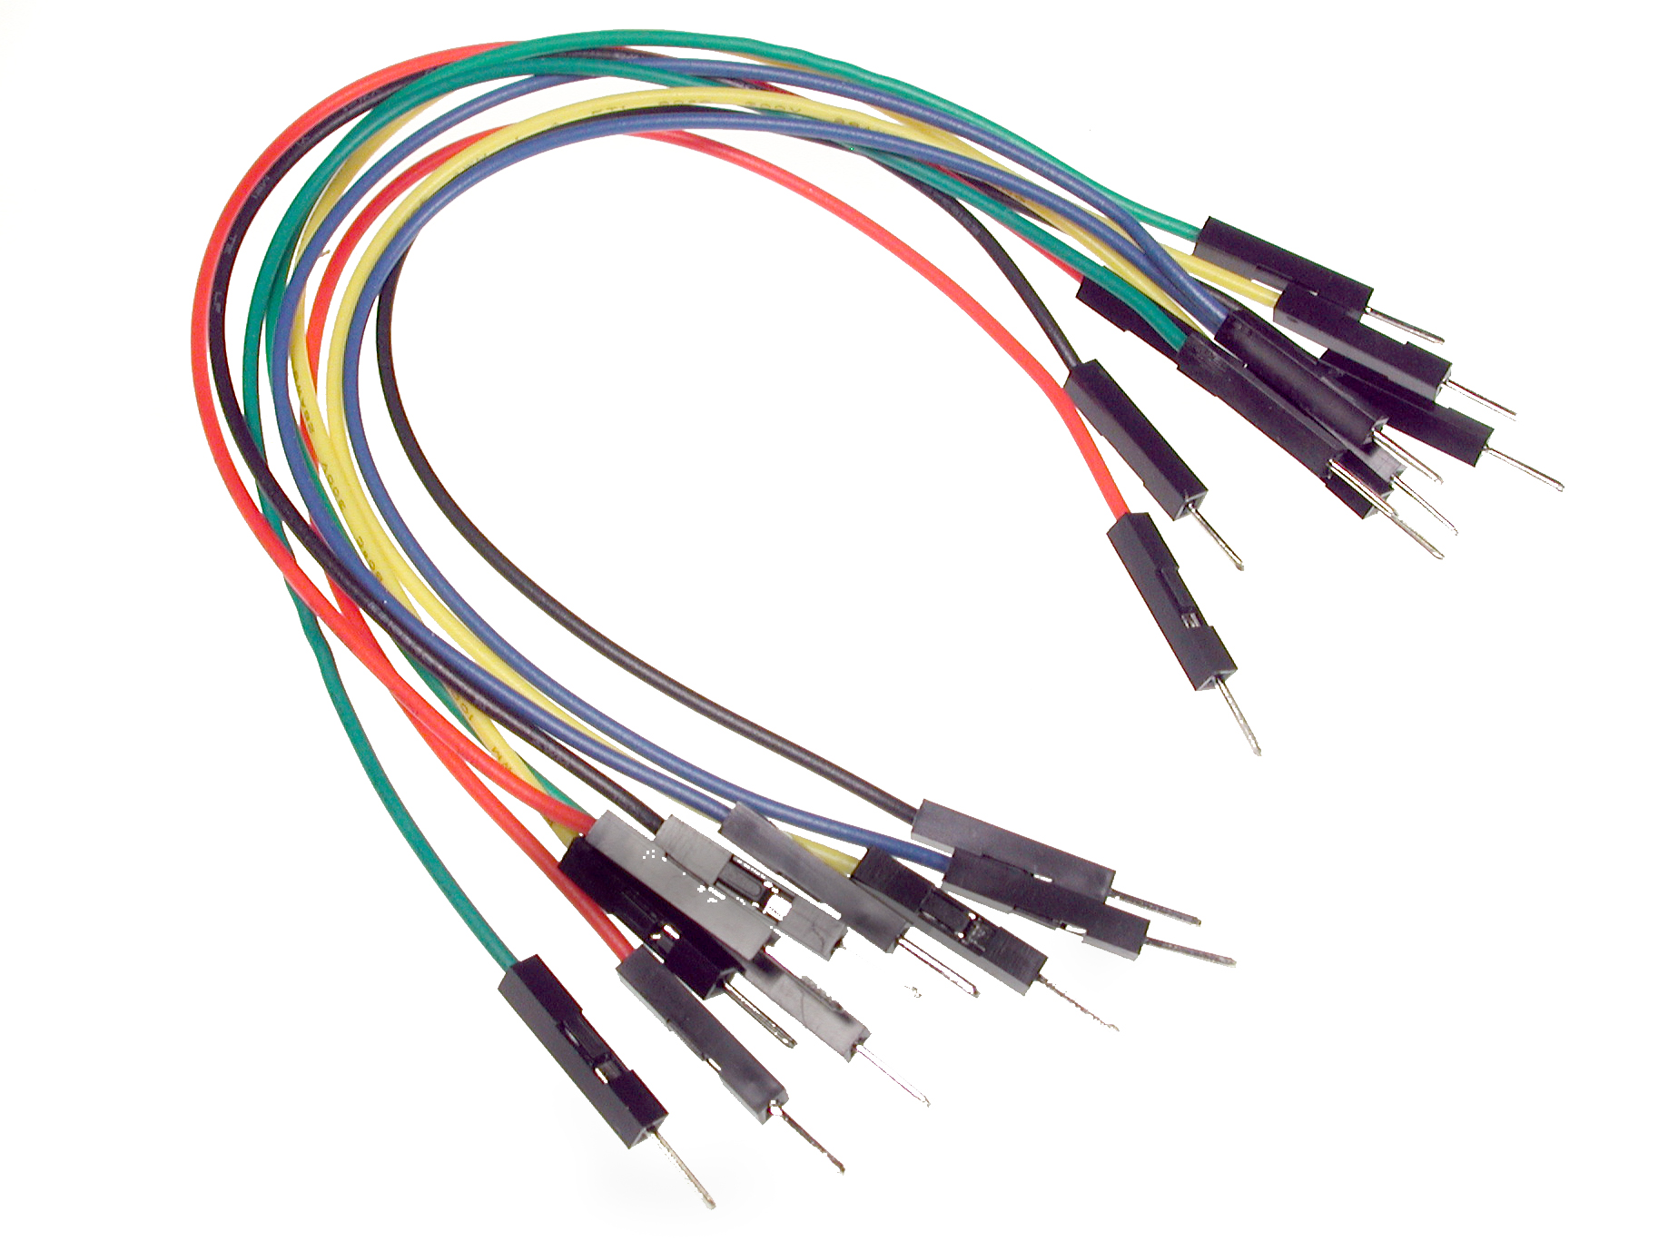
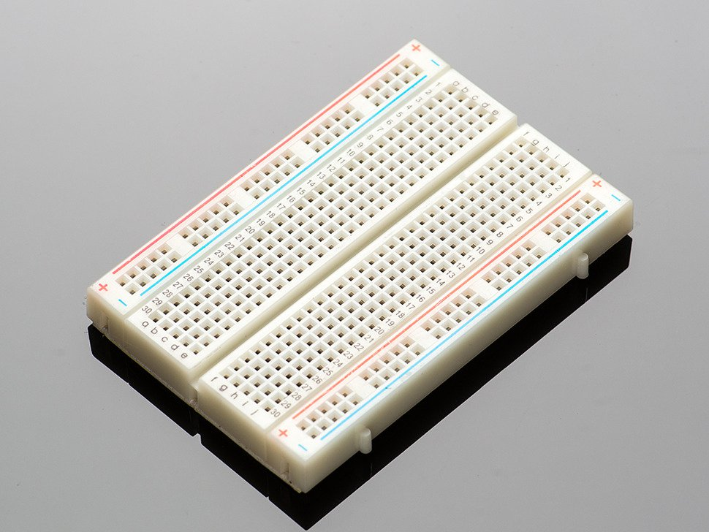
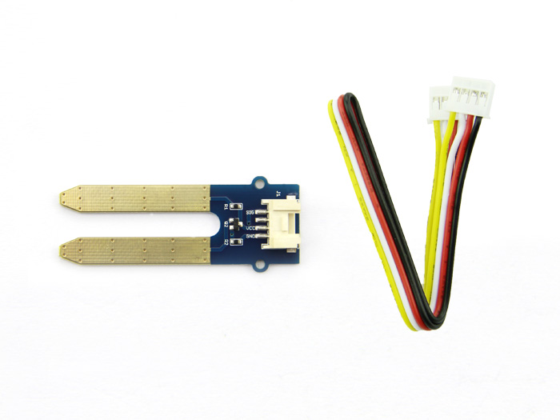
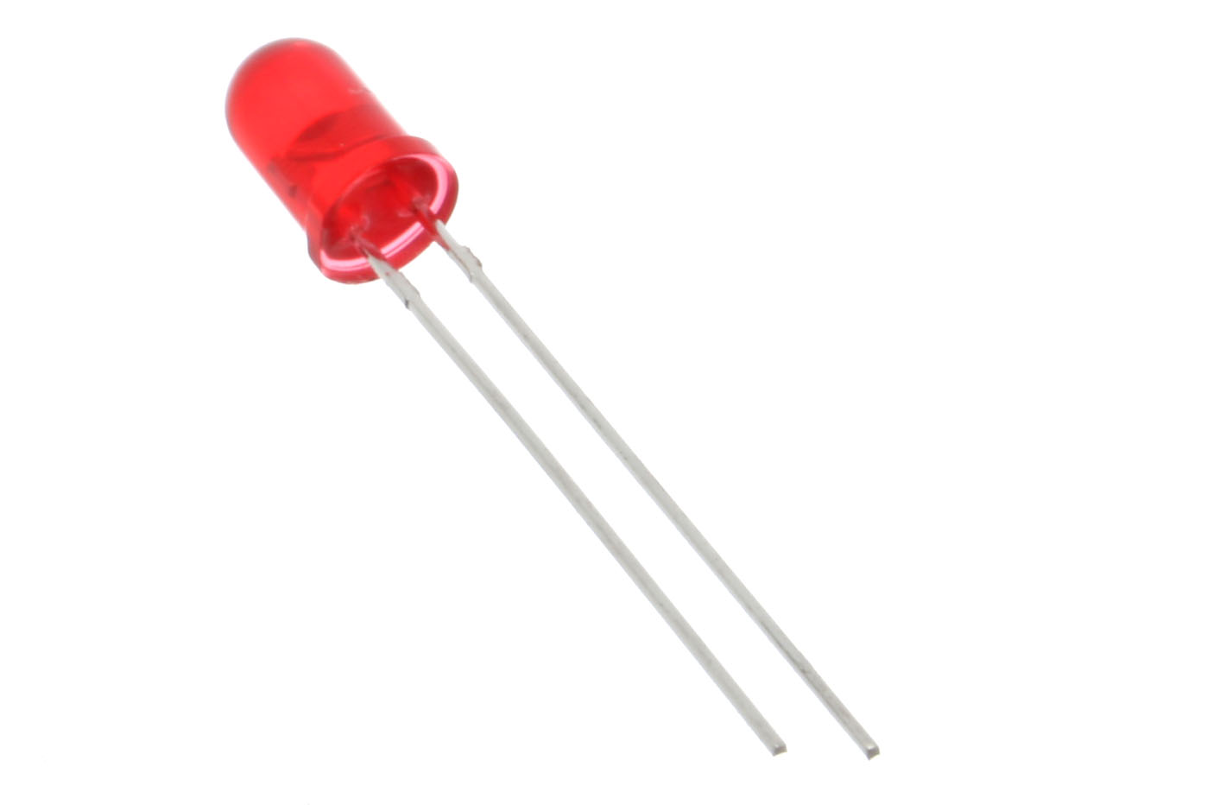
The parts
USB Port Power
Shadow box
LCD
D1 wifi UNO
330k
Resistor
Arduino UNO
Breadboard
Moisture Sensor
Jumper wires
LED

Slide 5
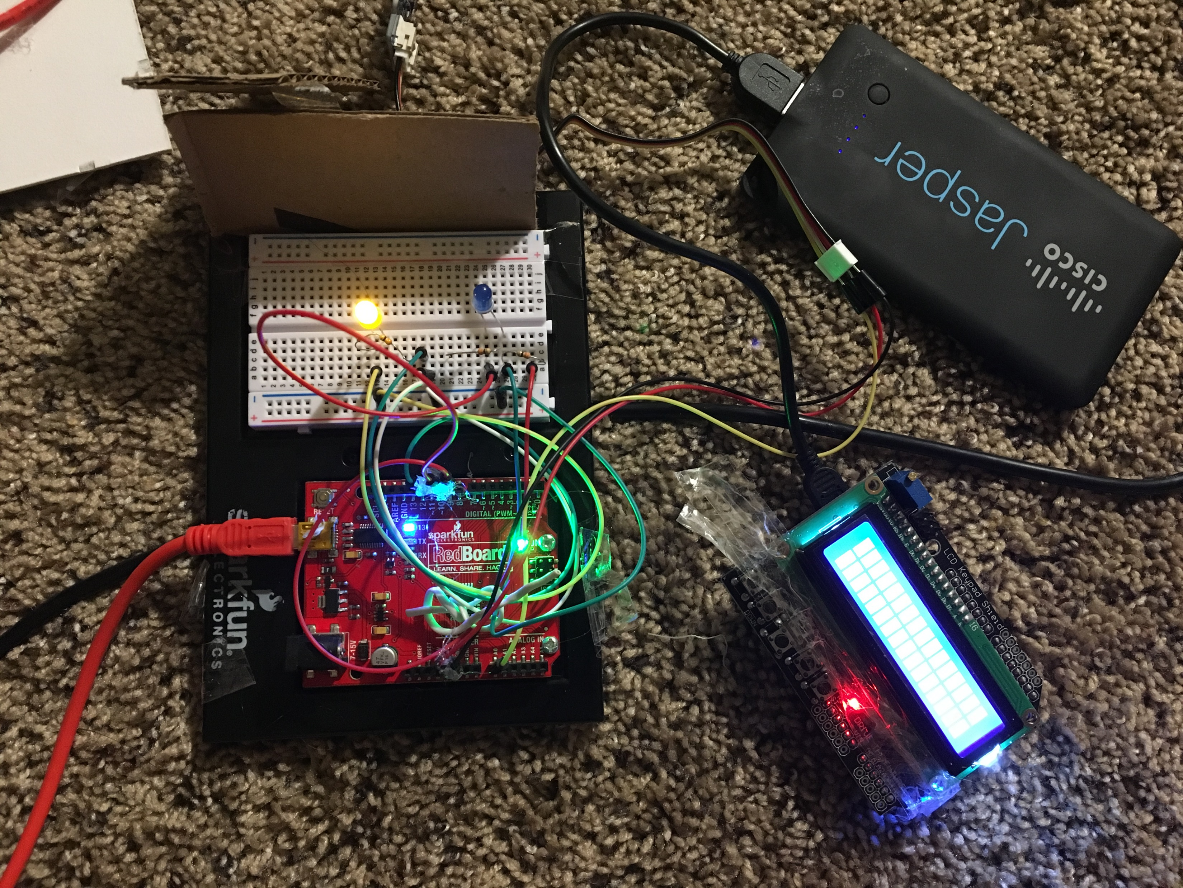

Slide 6
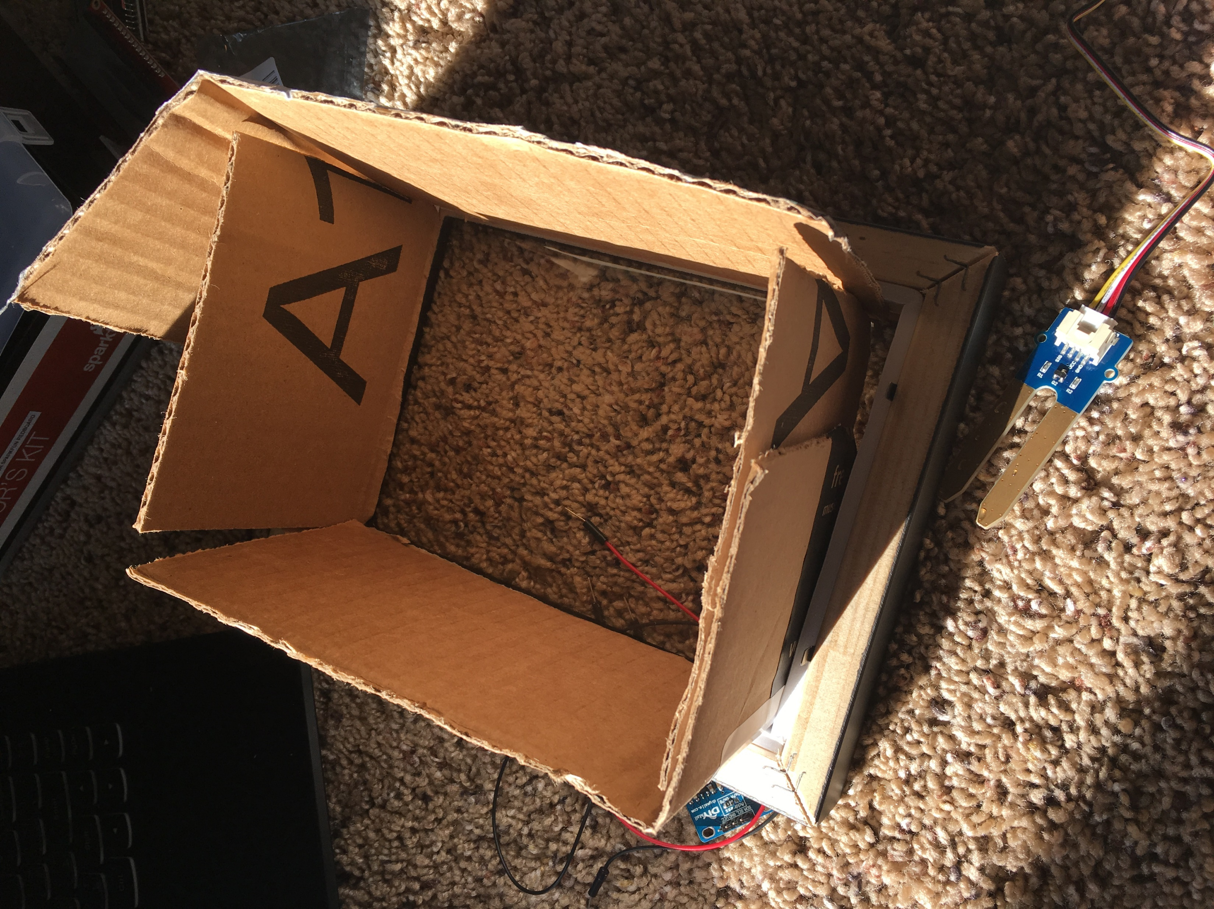
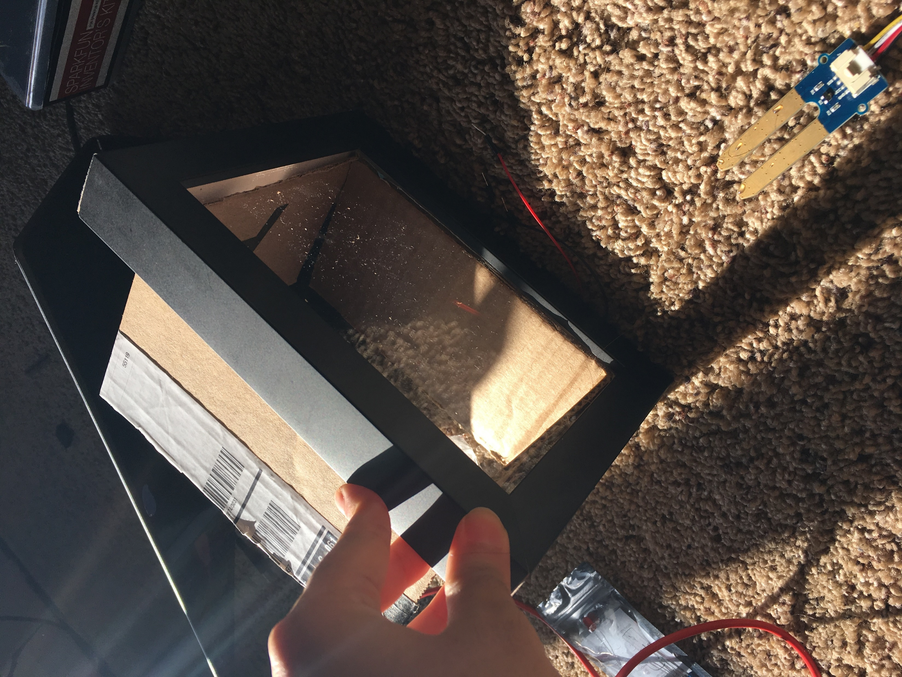

Slide 7
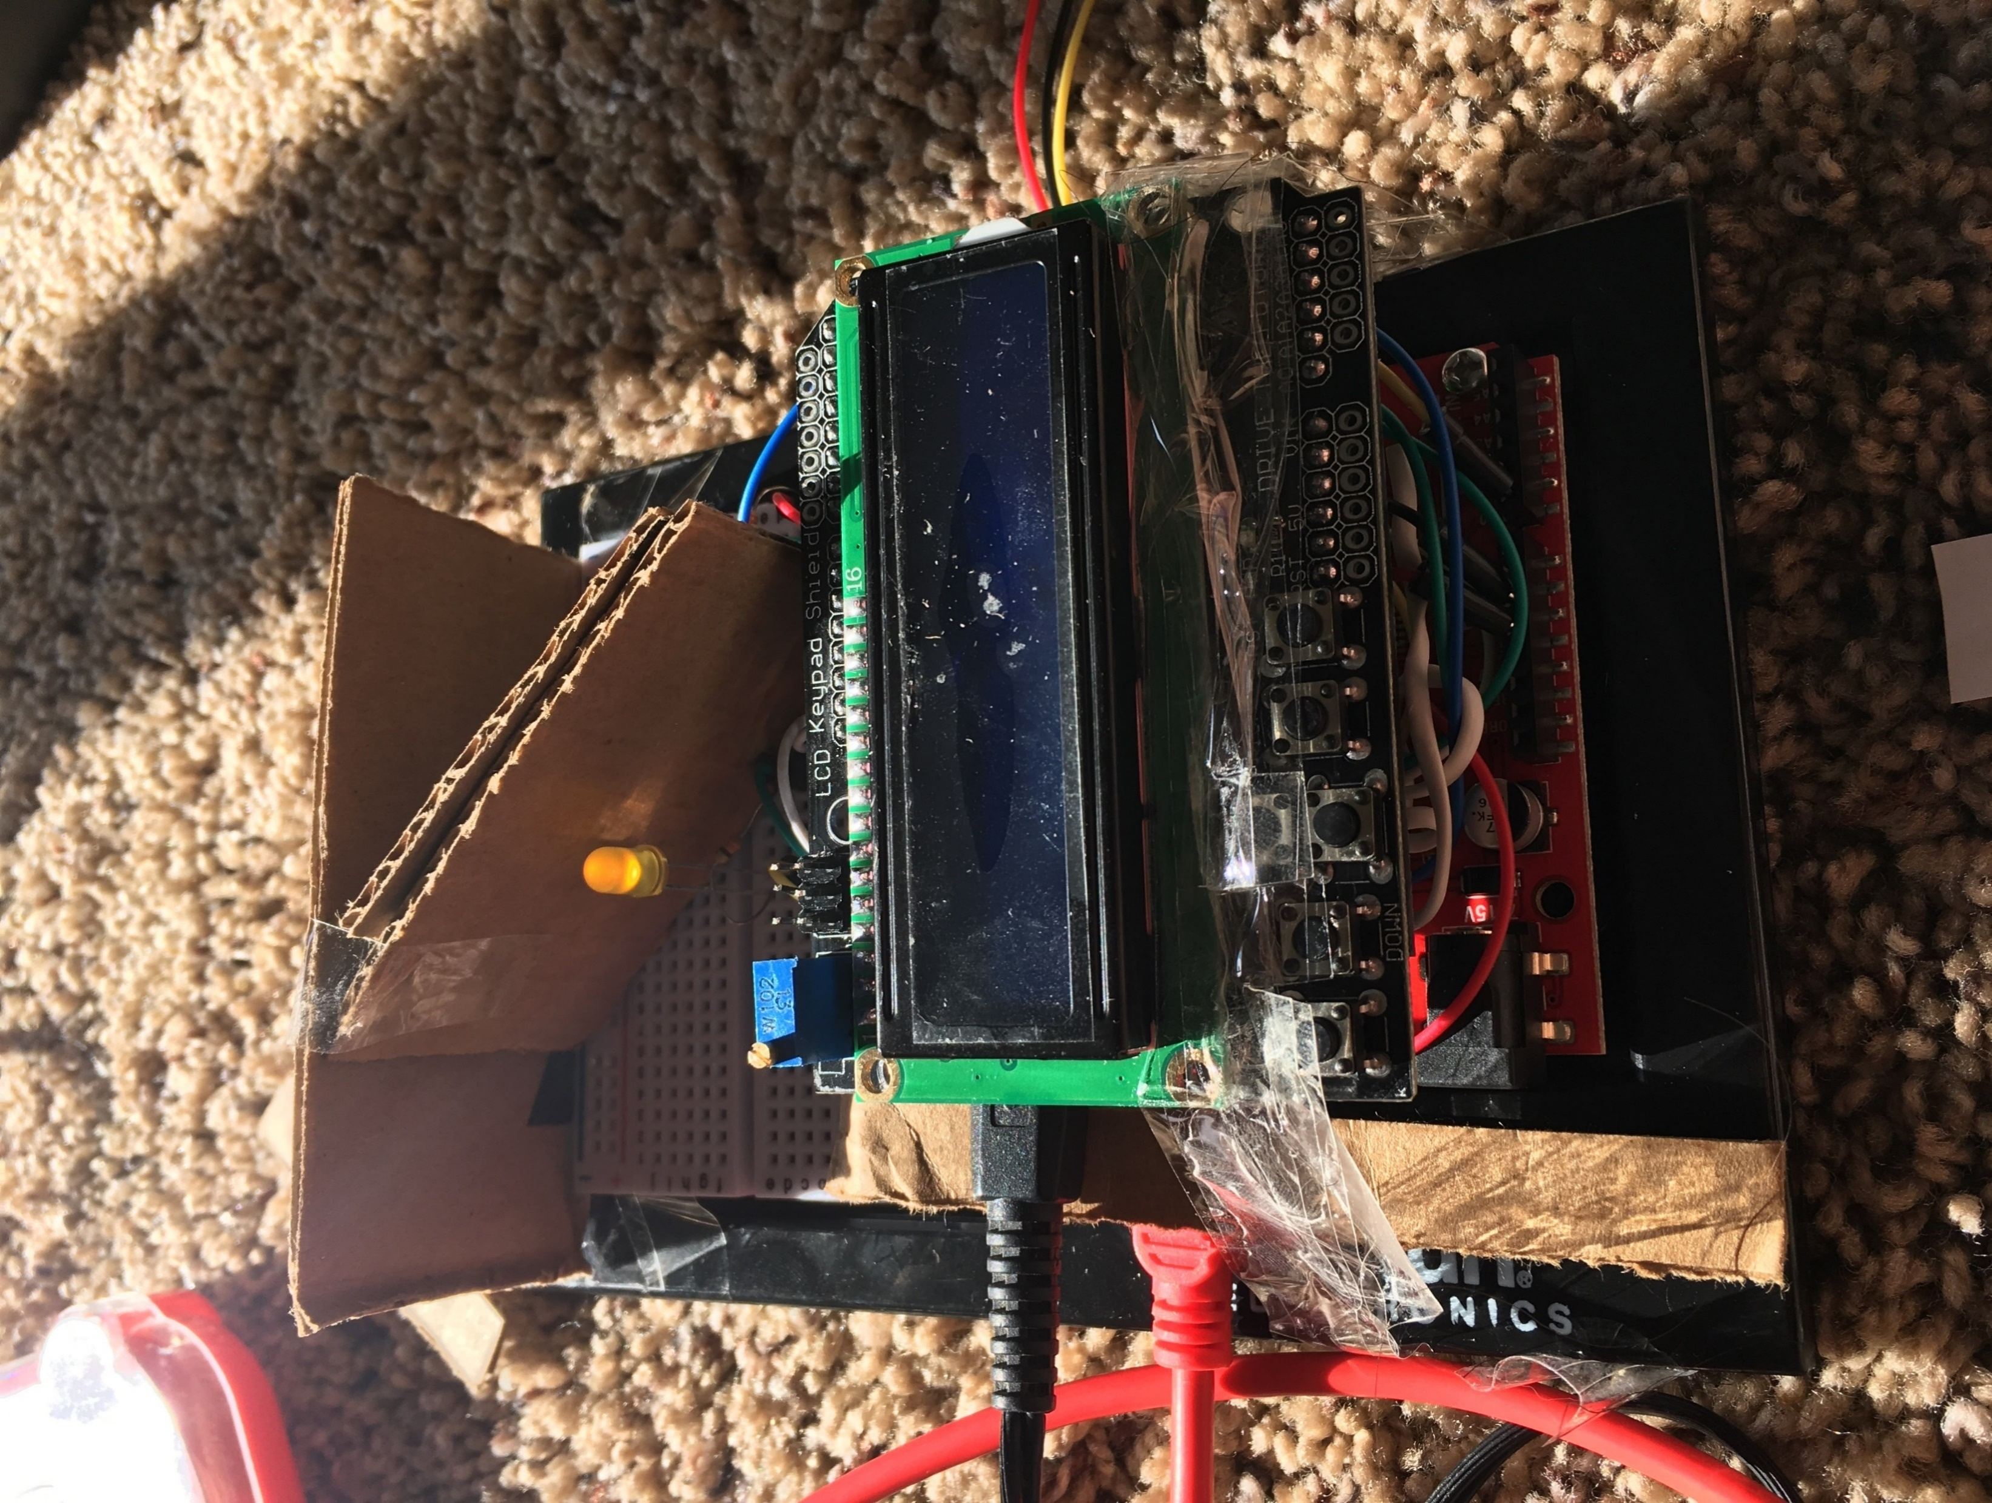
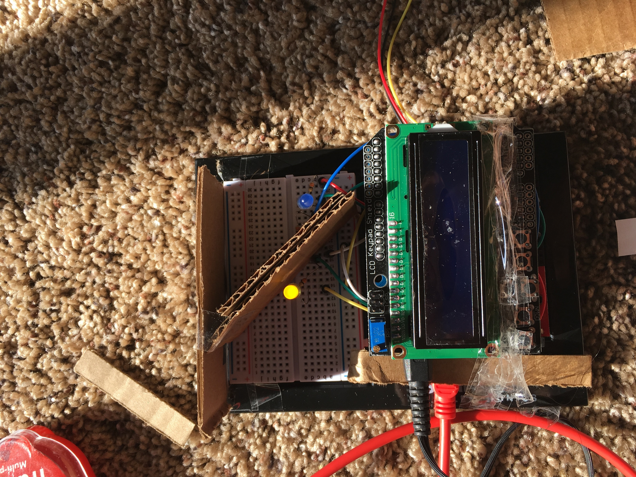

Slide 8
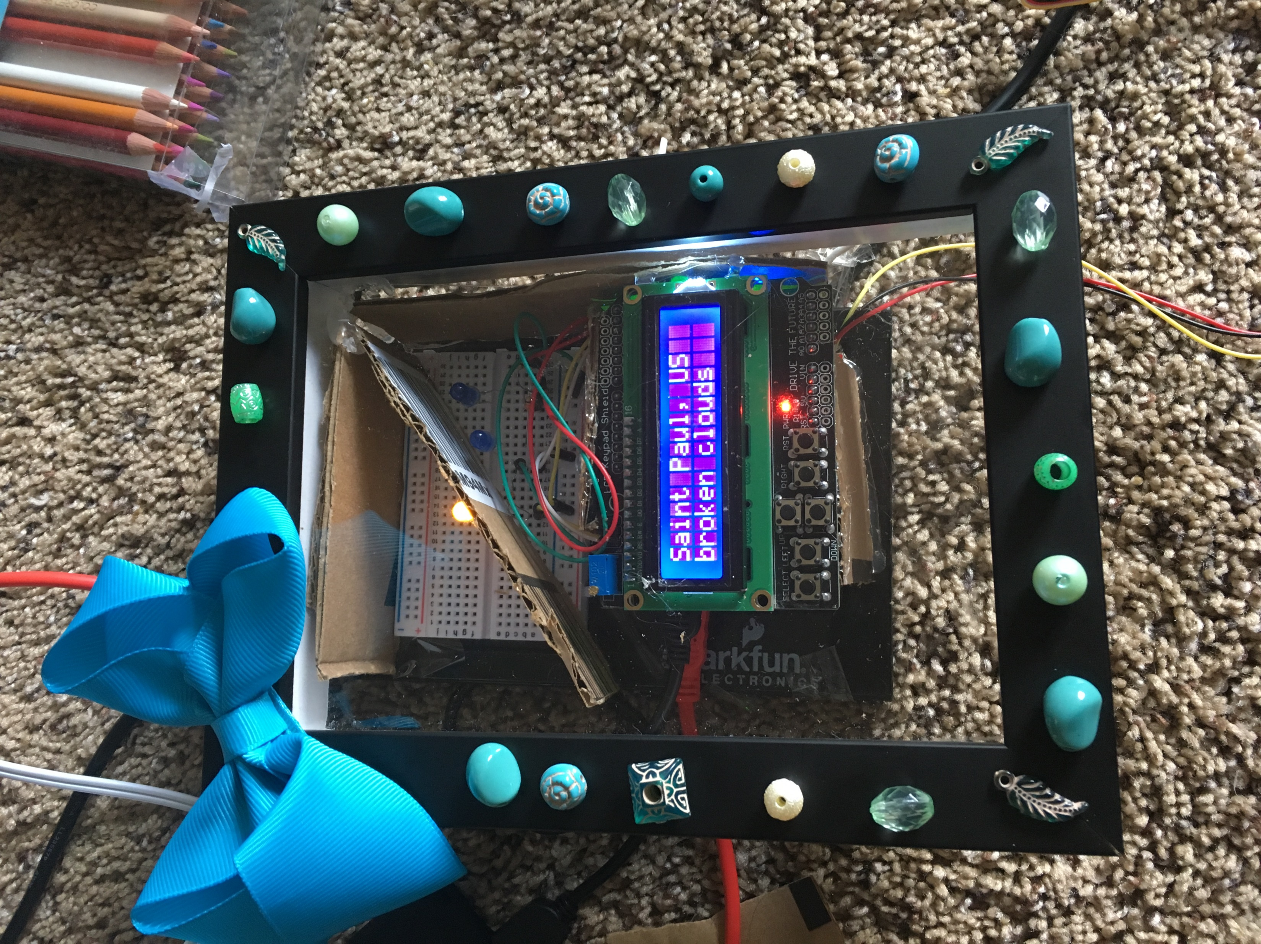
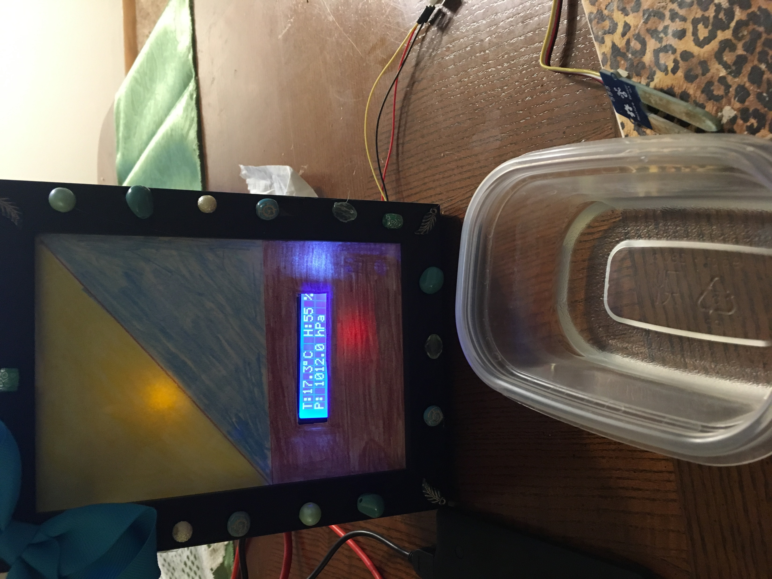

Slide 9
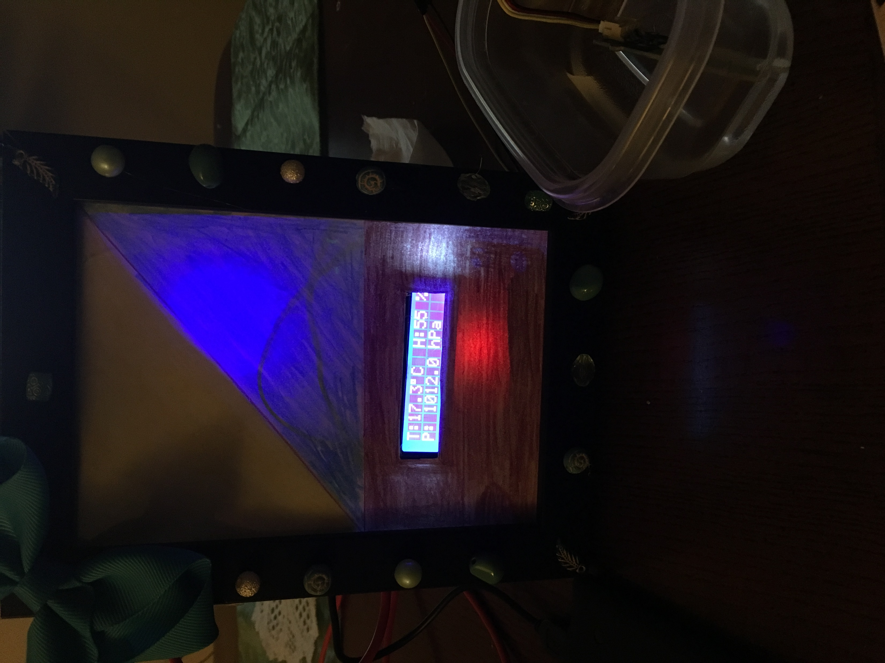
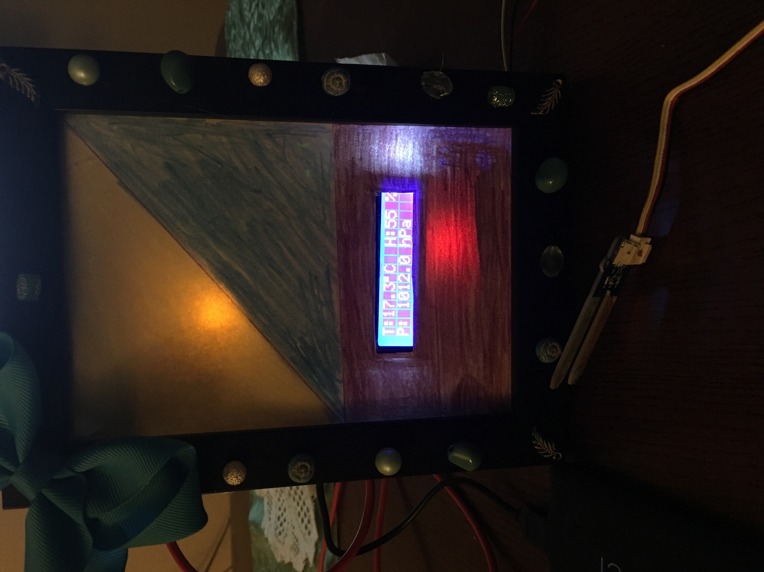

Slide 10
How does it work
The Moisture sensor is connected to yellow and blue LED light
If moisture sensor got wet it will flash the blue LED to show its raining otherwise the yellow LED will light to show that its clear sky
I connect the D1 UNO board to my home Wi-Fi network to download the weather data from the openweathermap.org website for my location. The data is updated every 10 minutes, then it will print on the LCD display
I had to add my username and password for my home Wi-Fi network
Add the API key from the openweathermap.org website
Add the city ID from openweathermap.org website

Slide 11
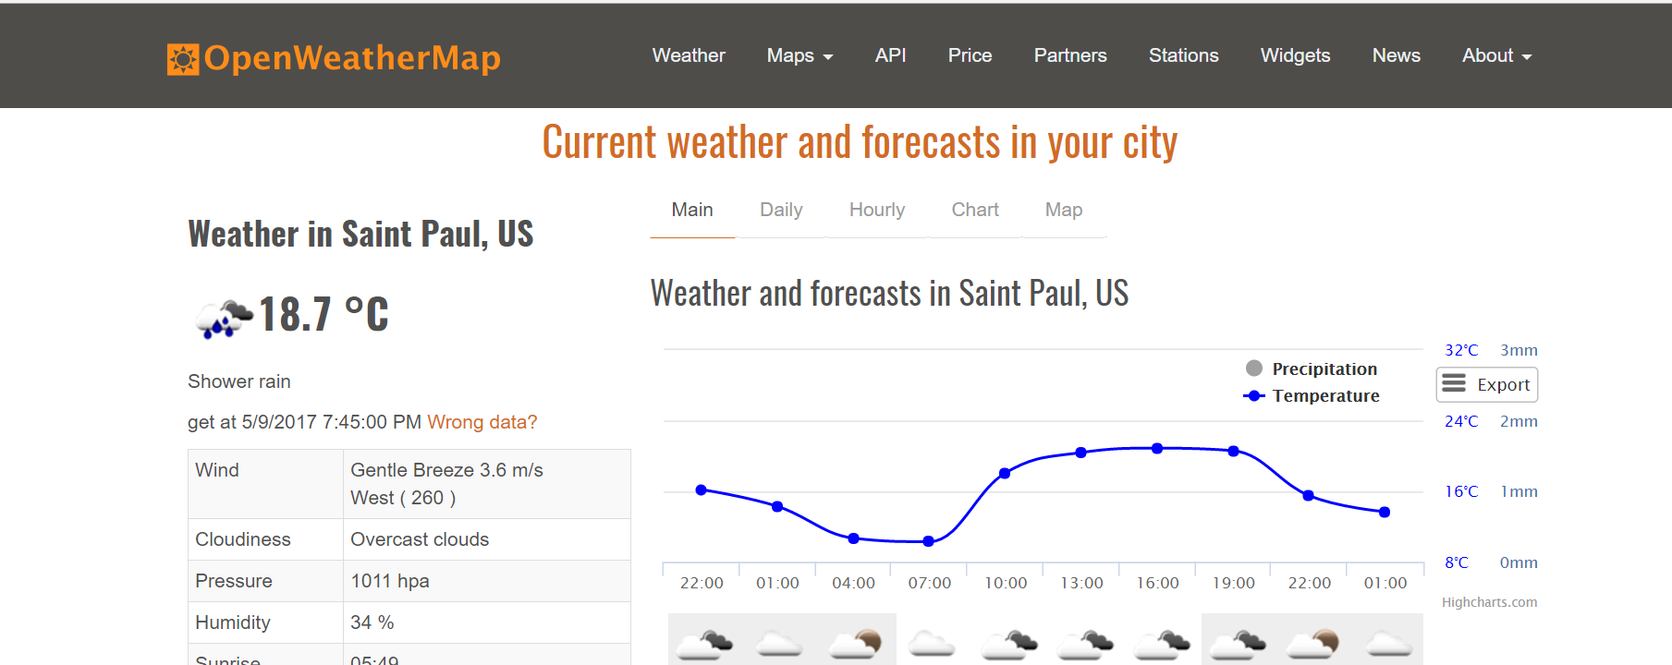
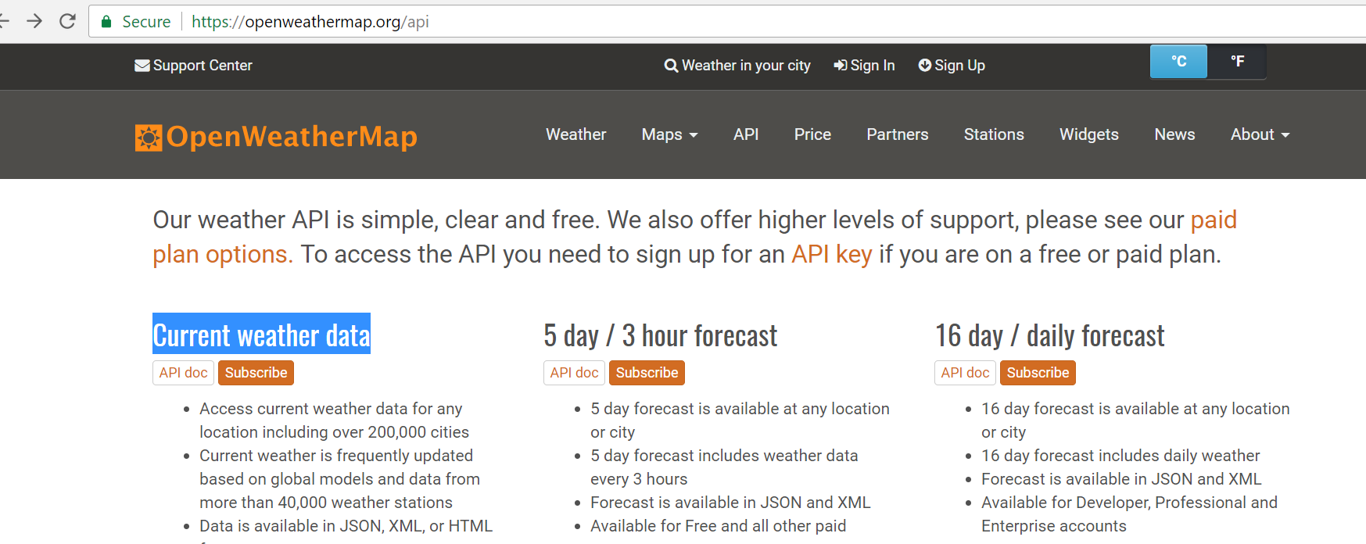
Pulling the weather data
Temperature
Pressure
Humidity

Slide 12
The code
From the attached Arduino file

Slide 13
The challenges
First, I had challenges with temperature sensor reading strange values, then I changed the idea to read the temperature from the cloud.
Finding the right library and Installing it was kind of challenge
It took me time to figure out why the LCD doesn’t show any characters and how to changing the LCD light brightness

Slide 14
Future
I want to continue improving this project
I want to play with the design little bit, such as change the fame size make it smaller
I want add more features such as light sensor for showing day-night
I want use it at home hang it on the wall, to get updated about the weather outside

Slide 15
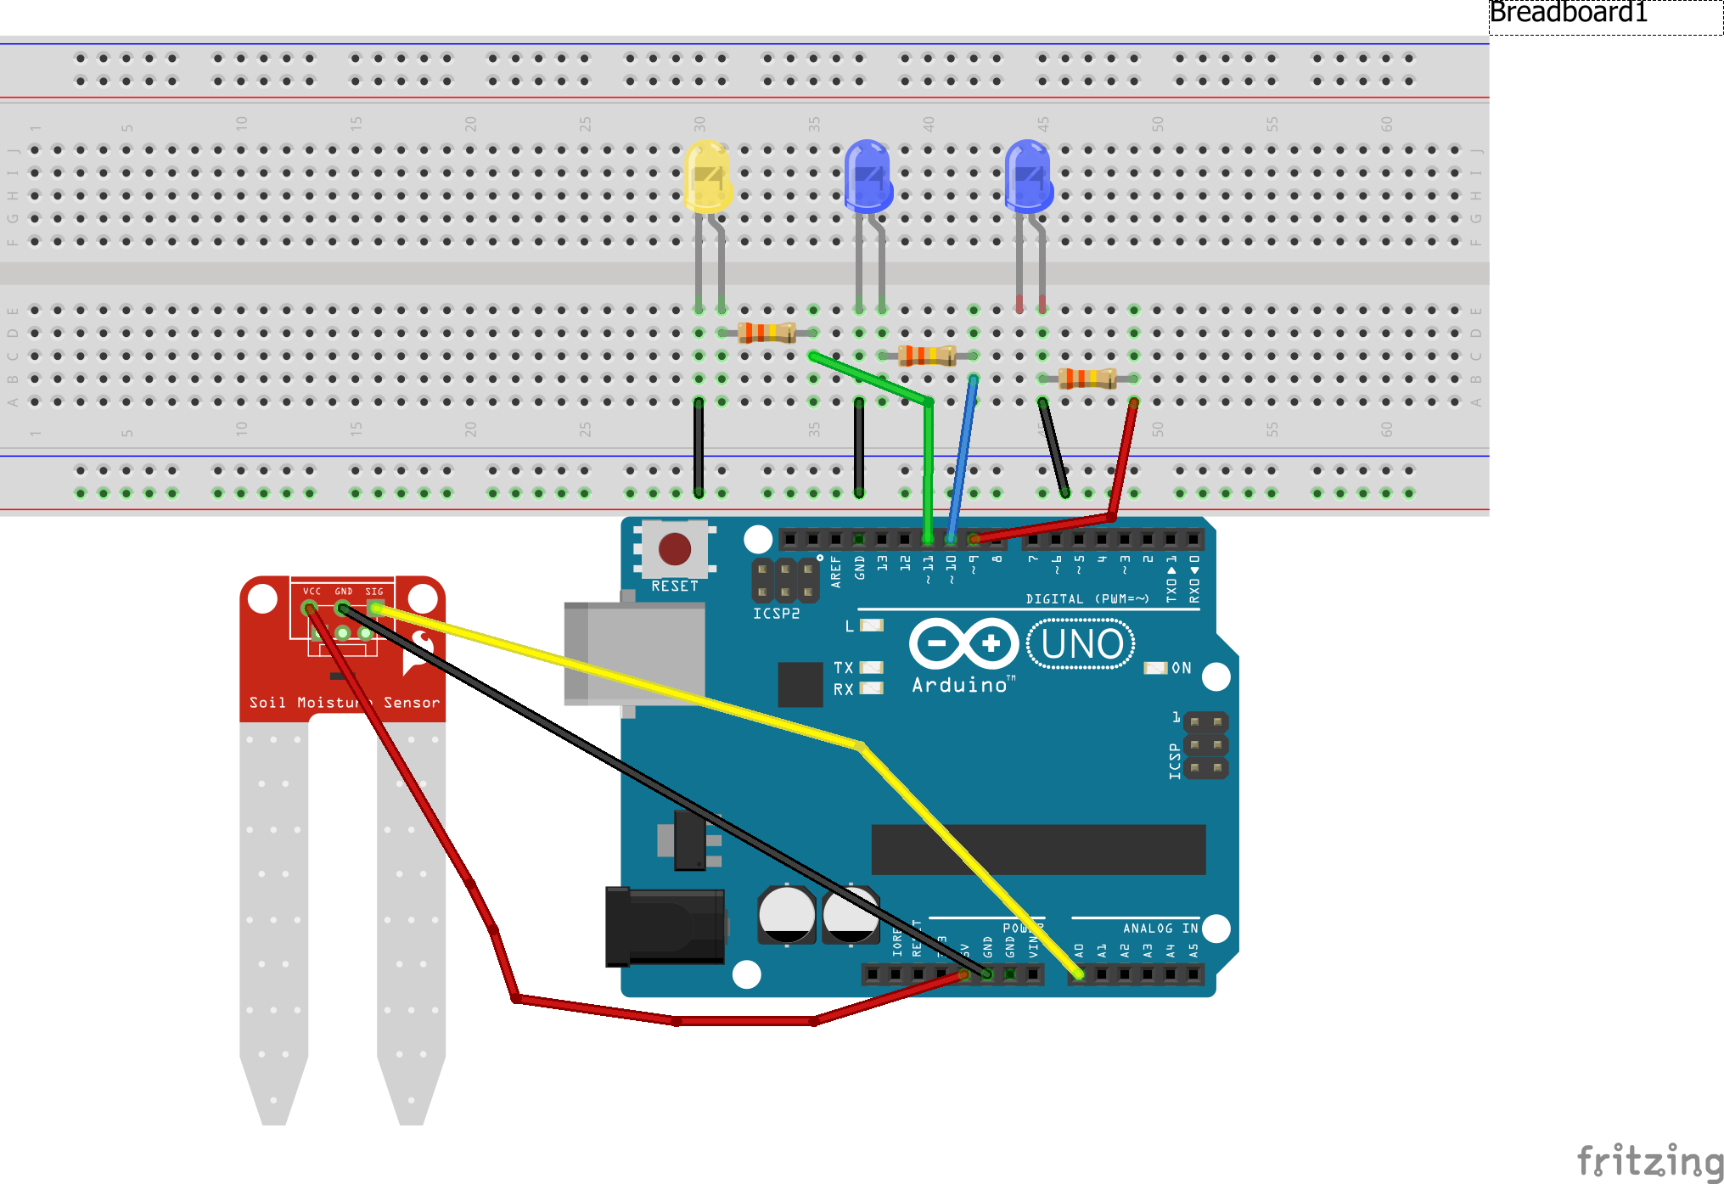
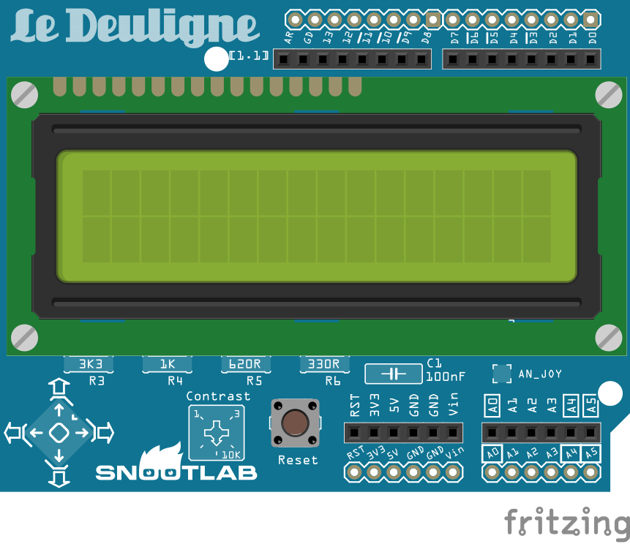
Fritzing

Slide 16
References
https://github.com/bblanchon/ArduinoJson
http
http://garagelab.com/page/tutorial-how-to-use-the-moisture-sensor-grove
https://openweathermap.org/
https://www.banggood.com/WeMos-D1-R2-WiFi-ESP8266-Development-Board-Compatible-Arduino-UNO-Program-By-Arduino-IDE-p-1011870.html?p=DQ30066511122014069J&utm_campaign=educ8stv&utm_content=huangwenjie
http://educ8s.tv/esp8266-weather-display/

